Slide 1
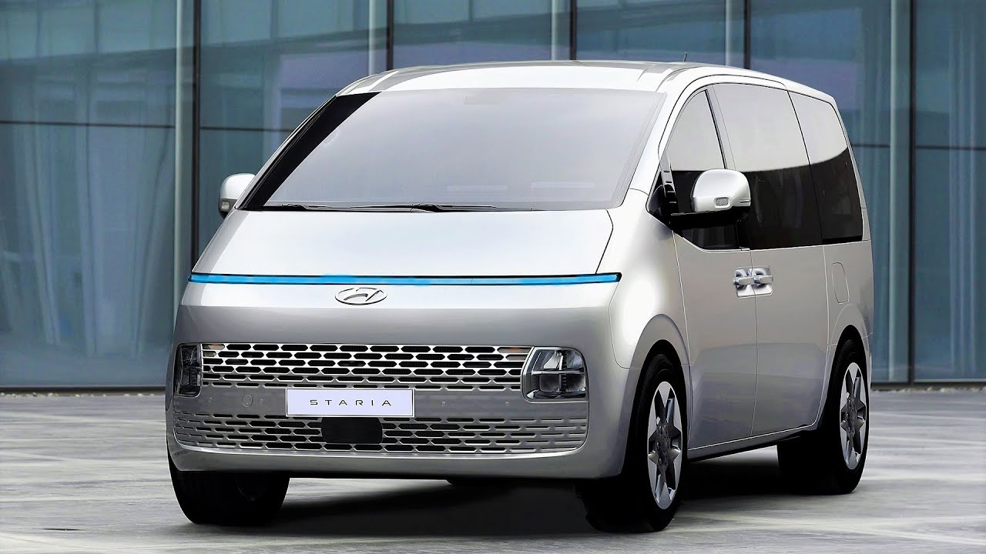
Grosse Pointe Associates
Microvan
Customer Perception & More 2-22-22
TEAm 32
Shiven Ahuja (ska21)
Joyce Gao(lg251)
Benazir Khurshid (bk190)
Zhiyang Ou (zo11)
Jason Yang(zy145)

Slide 2
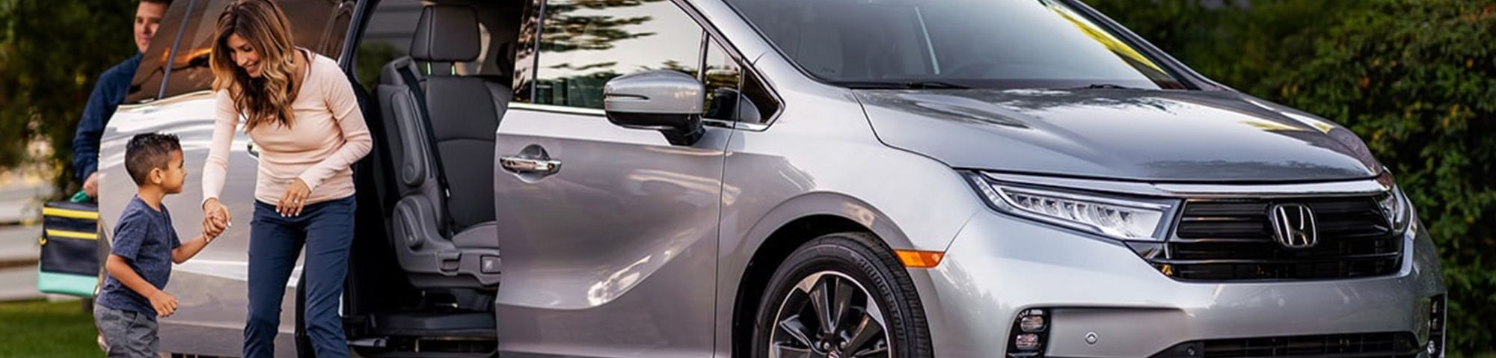
About us
At Grosse Pointe Associates, we empower businesses through data driven decision making to further drive innovation. By closing the loop on customer requirements, we help automotive giants brainstorm better features for each target segment. ​
About

Slide 3
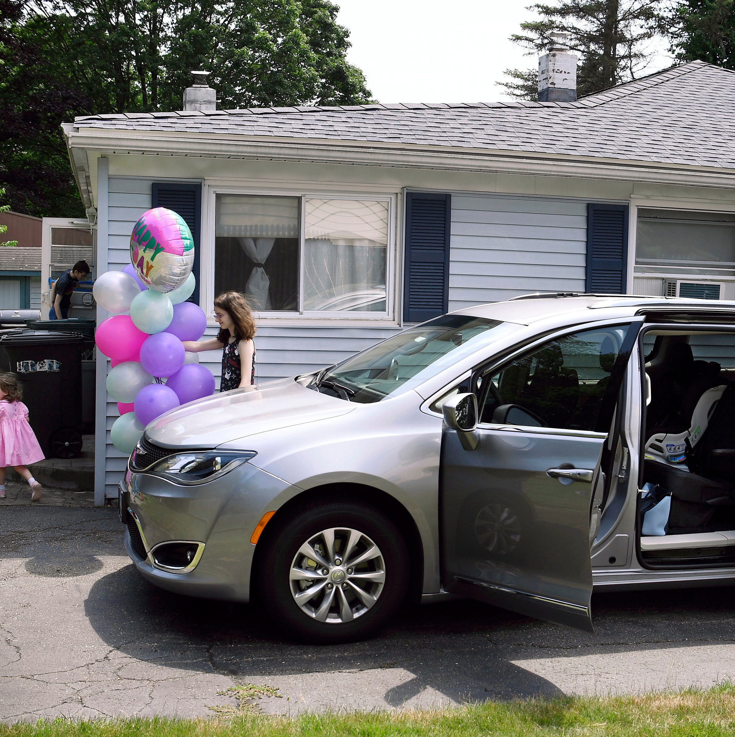
Problem
To better understand the possible automobile attributes and psychographic variables that might affect consumers’ buying decisions towards the microvan.
Market

Slide 4
SOLUTION
Understand correlation between variables
Check distributions using histogram
Check for significant variables in initial model
Perform Hierarchical and K-Means clustering
Explore and understand the customers in each cluster
Who is our most important customer and how do we outreach them
Factor Analysis
Demographic Analysis
Understand the business needs of each of the customers cohorts created
Solution
Evaluate the data, ran Bartletts Test of Sphericity, ran KMO test
Determine no. of factors through the plot
Run factor model to compare with initial model
Initial Model
Clustering
Business Insight

Slide 5
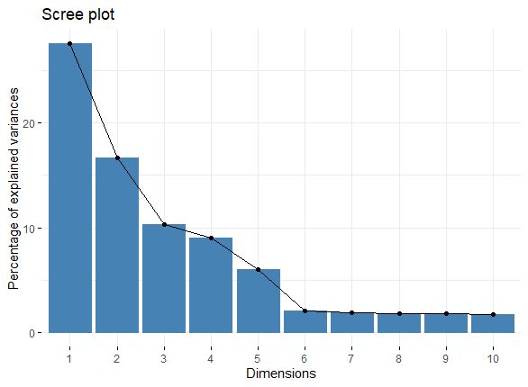
SOLUTION
Factor 1 | Factor 2 | Factor 3 | Factor 4 | Factor 5
Premium Quality | Capacity & Seating | Affordability & Safety | Environmentally Friendly | Durability & Safety
Factor Analysis
Top five factors explain 70% of the variations
Solution
Initial Model

Slide 6
SOLUTION
Cluster 1 – 31.75%
Affluent Families
Inelastic Higher End Consumers
Not environmentally conscious
Quality Racing Enthusiasts
Cluster 2 – 39.25%
Middle Class Families
Less Features
Economical Option
Solution
Clustering
Cluster 3 – 29%
Educated Large Families
Environmentally Friendly
Durable, Safe and high Capacity Option

Slide 7
SOLUTION
Cohort 2
Young (65%)
Low Income (60%)
Drive less miles (55%)
One child or no children (90%)
Primarily till Secondary education
Cohort 3
Cohort 1
Middle Aged (65%)
Moderate (65%) or High (30%) Income
Daily driving commute (95%)
At least two children (65%)
Very highly Educated
Old and Middle Aged (95%)
Very High Income (60%)
Value Driving Experience (80%)
Only one child (65%)
Highly Educated
Demographic Analysis
Solution

Slide 8
SOLUTION
Target Segment - Educated Large Families (Cluster 3)
70% of the target segment has given score > 6
Segment values quality, durability, capacity, environment, and safety.
Positioning
Microvan that combines luxury with utility
Premium durable car
Offers a comfortable ride to the entire family for long mileage runs.
Perfect compact van that is great for group travels
Very safe ride for kids and can be a selling point for families with young ones
Segment value the environment, the microvan can be marketed as an economical ride offering good mileage per gallon.
Solution
Business Insight
Business Insight

Slide 9
Thank YOU
TEAm 32
Shiven Ahuja (ska21)
Joyce Gao(lg251)
Benazir Khurshid (bk190)
Zhiyang Ou (zo11)
Jason Yang(zy145)

